Slide 1
Setting up Login Approvals for Students on Populi
(Multi-Factor Authentication)

Slide 2
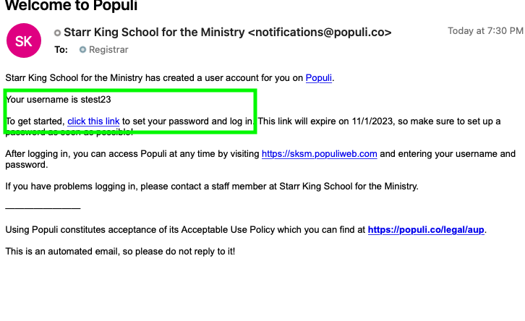
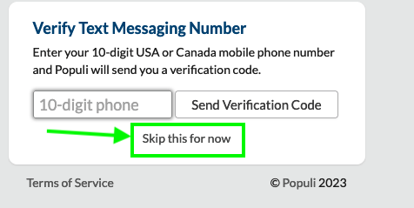
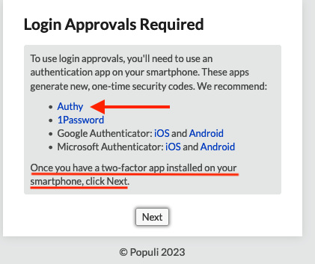
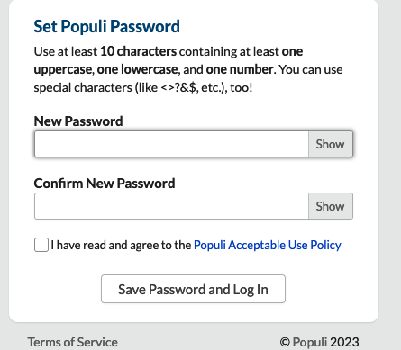
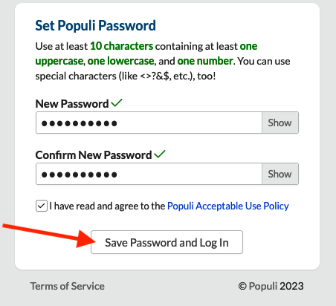
How to Set Up Your Populi the First Time
2. Skip for now
1.Check your email and click the link to log into Populi for the first time or after requesting a password reset. Note your user name
4. Click the link to download Authy.
Don’t click “Next” yet– First download the Authy app to your smartphone (or your desktop if you don’t have smartphone) and link it to your Populi
3. Set a password for your Populi
Notes:
Check your email if you are new to Populi. An account has been set up for you, you will find the information in your “Welcome to Populi” email that came to your school email address. You can also find your Populi User Name and the Populi URL in your “Welcome to Starr King” email.
Once your Populi account and password are set up, the ”Login Approvals Required” box will appear. Click the link to download the Authy authenticator app to your smartphone (or desktop if you don’t have a smartphone). Don’t click “next” until you have downloaded the app.

Slide 3
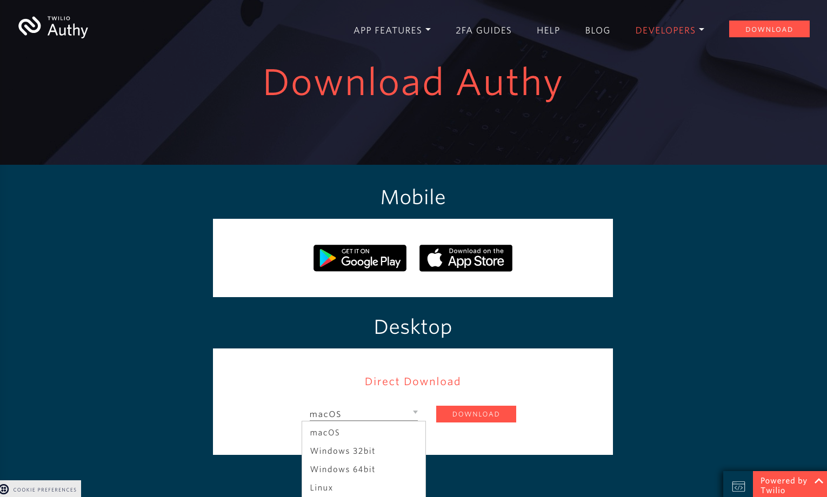
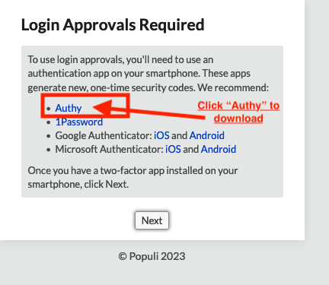
How to Download the Authy Authenticator App to Your Smartphone or Desktop
(YOU ONLY DO THIS ONCE, DURING SET UP)
Notes:
To download the app, click the “Authy” link, and it will bring you to the Authy website where you can download the Authy app for either type of smartphone or many types of desktops systems. For smartphones you can also search in the app stores for “Authy Authenticator App”.
NOTE: You will only need to do this once, on initial set up.

Slide 4
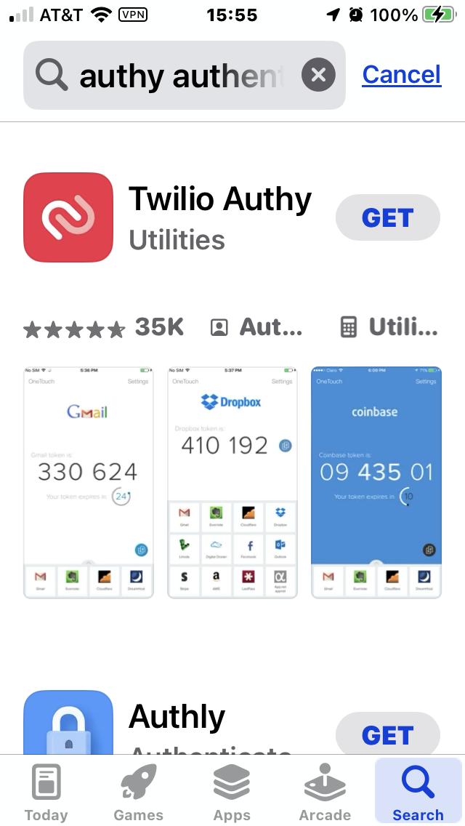
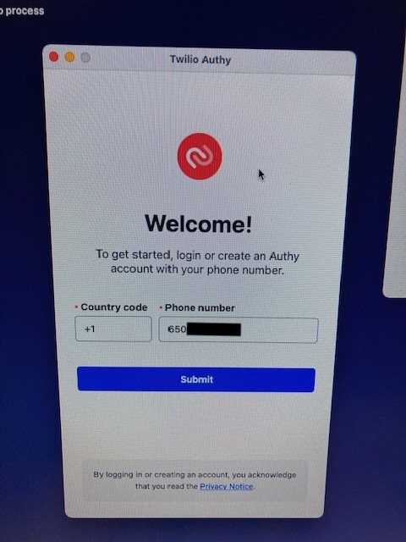
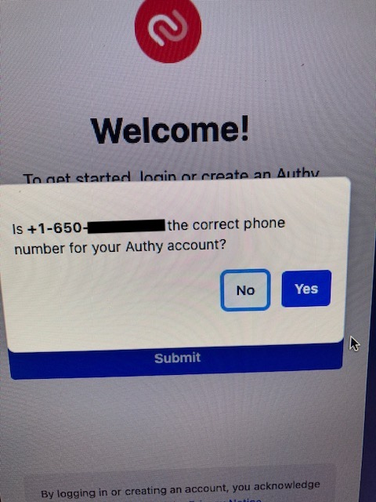
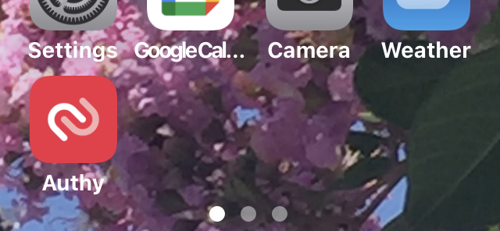
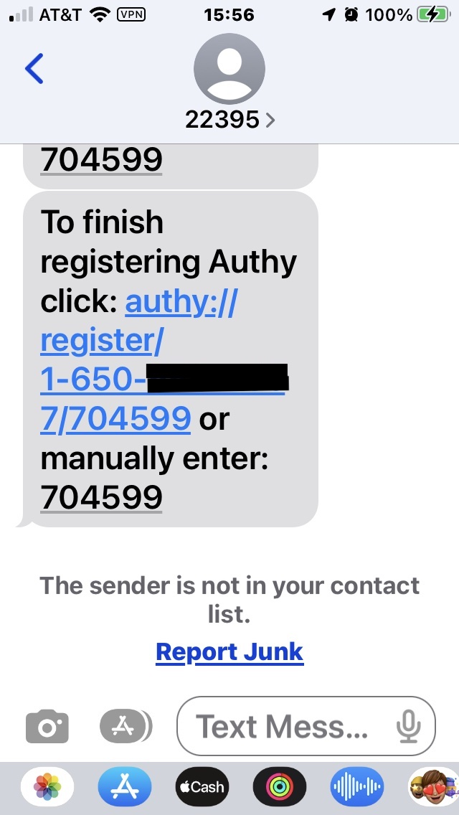
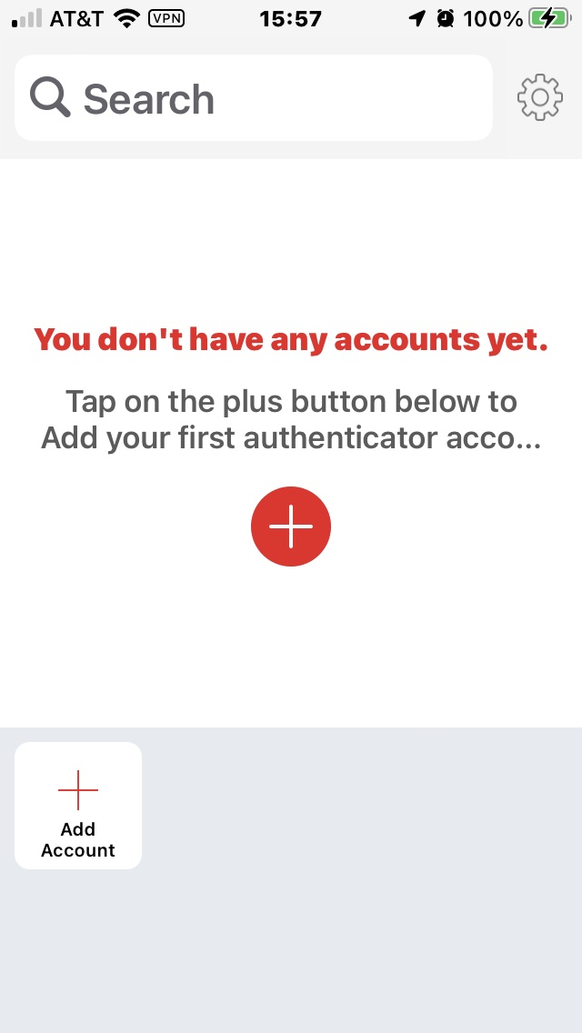
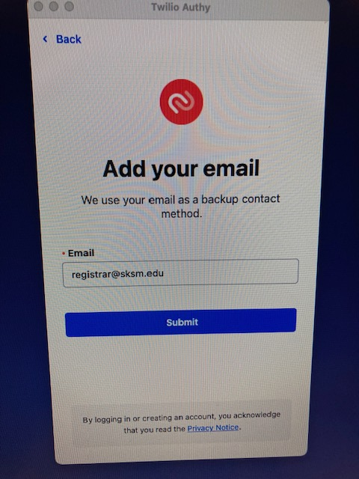
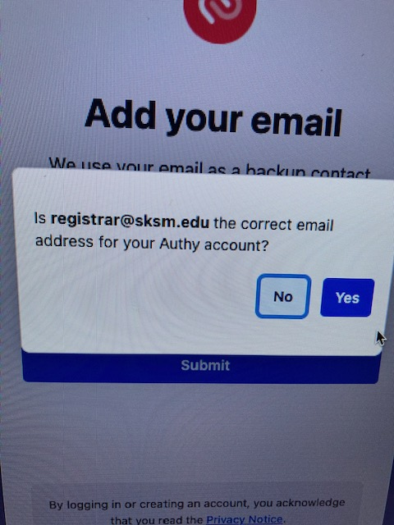
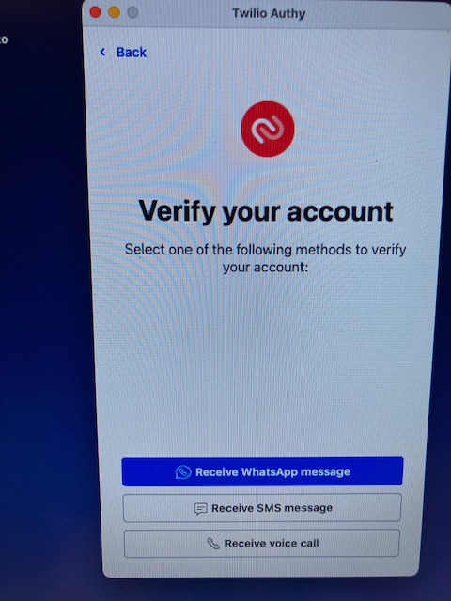
How to Download the Authy Authenticator App to Your Smartphone and Set Up An Authy Account (YOU ONLY DO THIS ONCE, DURING SET UP)
2. Double click Authy icon on your phone screen to open and set up Authy account
1. Search for and install Authy from your smartphone app store
3. Follow instructions for adding your phone number
4. Confirm phone
5. Follow instructions for adding email
7. Authy will send you a one time code by method of your choice
8. Retrieve the code and enter it to your smartphone
9. Once you successfully input the one time code, you will see this screen and you are ready to add Populi to your Authy
6. Confirm email
Notes:
Follow instructions to download and install the Authy app on your smartphone and set up your free Authy account.
NOTE: This step is only done once, when you first set up your Login Approvals. (Though if you get a new phone you would need to email Registrar@sksm.edu to “reset your Login Approvals”, and you would do this step again).

Slide 5
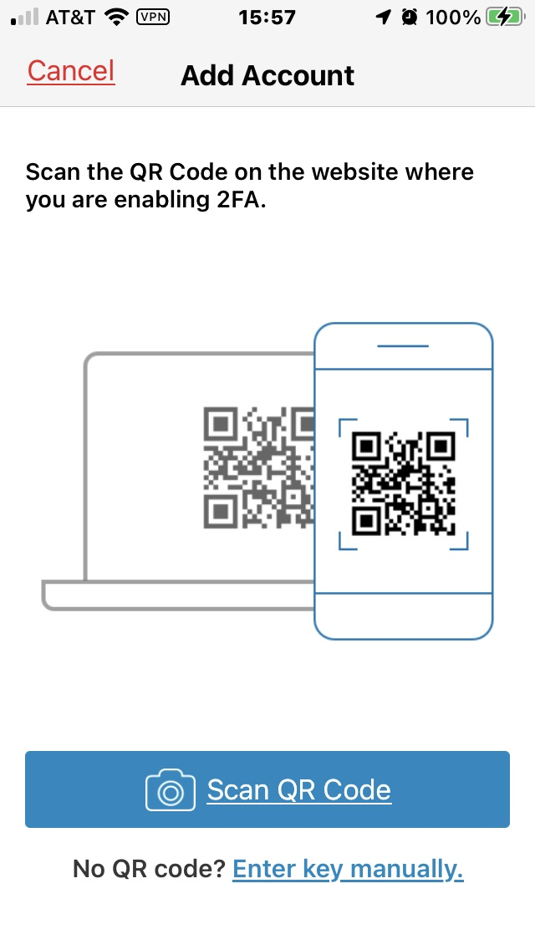
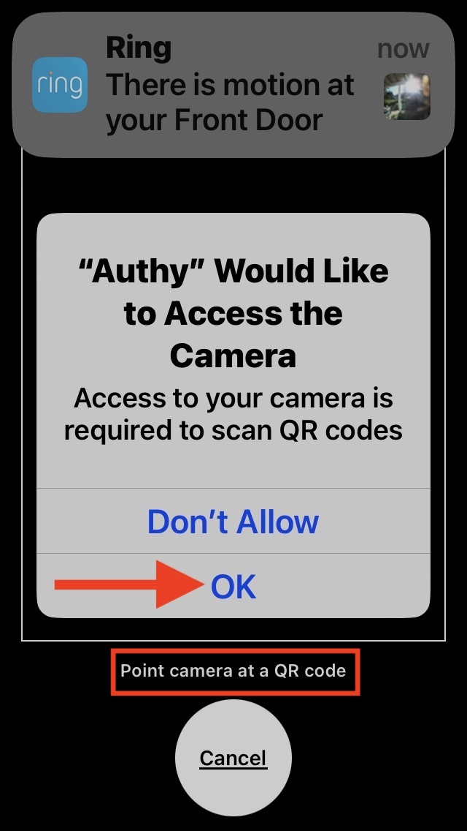
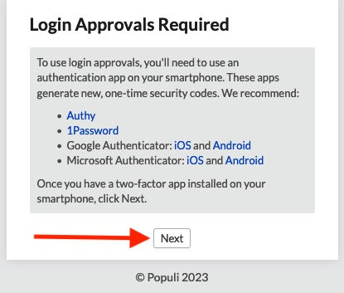
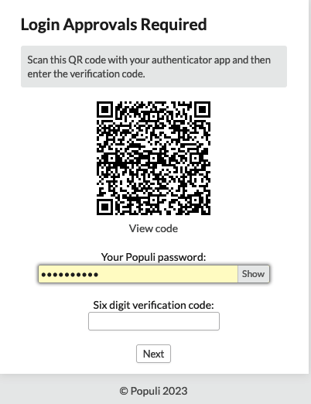
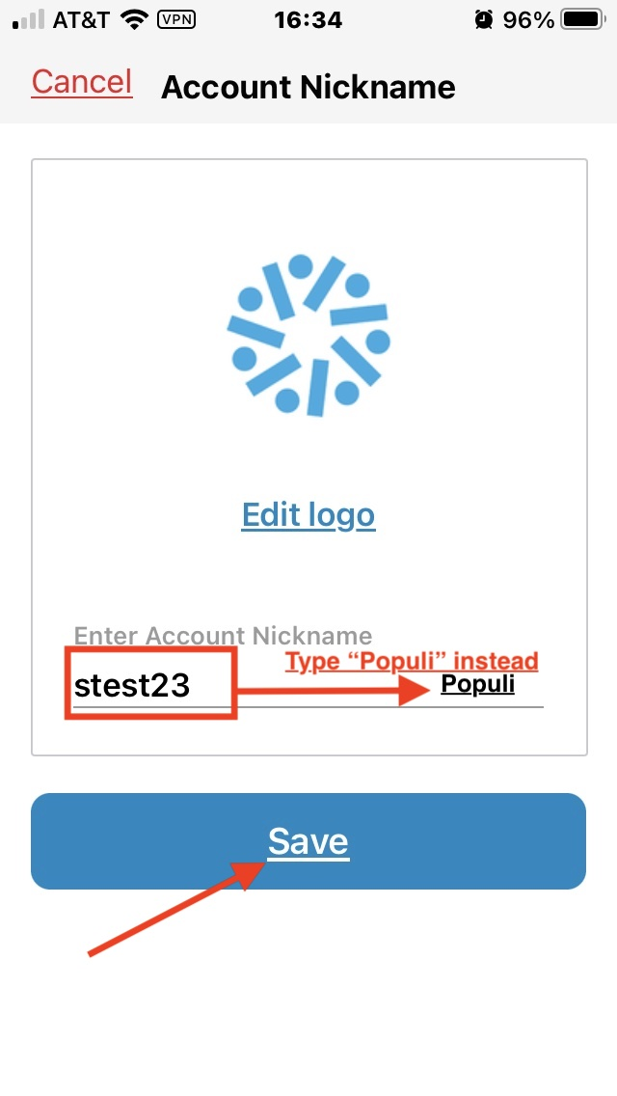
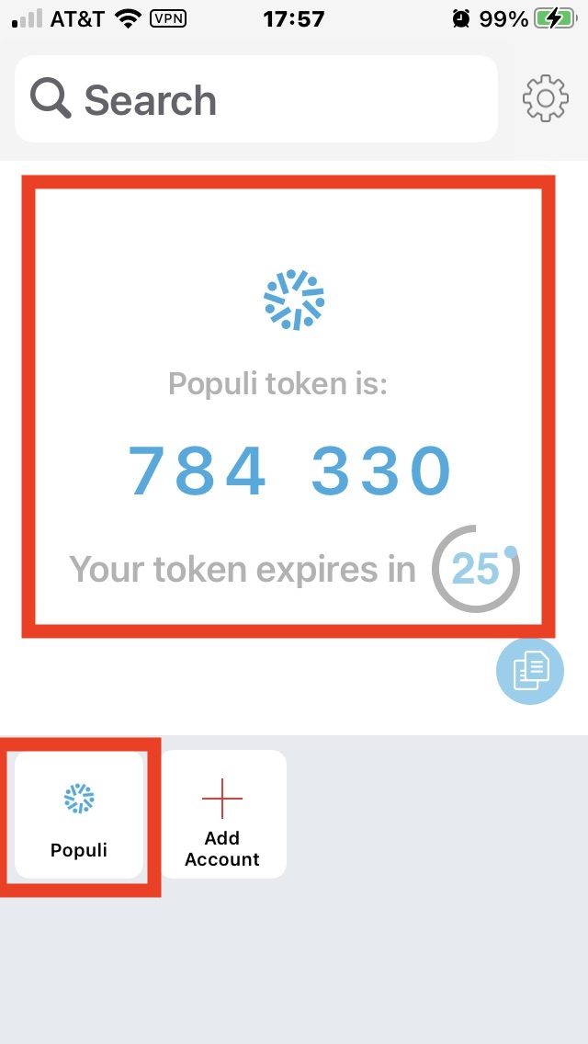
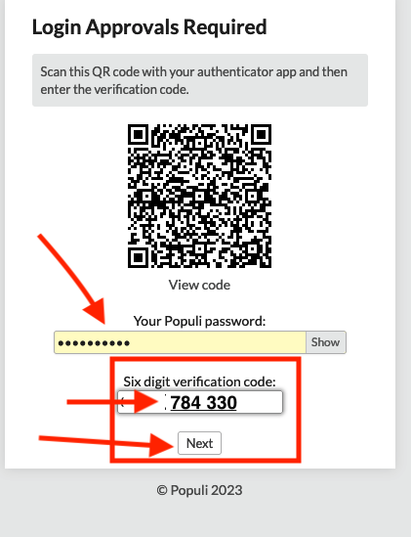
How to Link Your Authy Authenticator App on Your Smartphone to Your Populi
(YOU ONLY DO THIS ONCE, DURING SET UP)
1. After you click the + sign to add, you will see this screen
2. Now click “next”
3. Populi will now display a QR code for you to scan with your smartphone camera
4. Click “ok” to allow Authy access to your camera
5. Change the “account name” to “Populi”, and hit “save”
6. Put the 6-digit code generated by the Authy app into the appropriate field on your Populi (under the QR code and your Populi password), and click “next”
Notes:
Follow instructions to link your Authy app on your smartphone to your Populi.
NOTE: This step is only done once, when you first set up your Login Approvals.

Slide 6
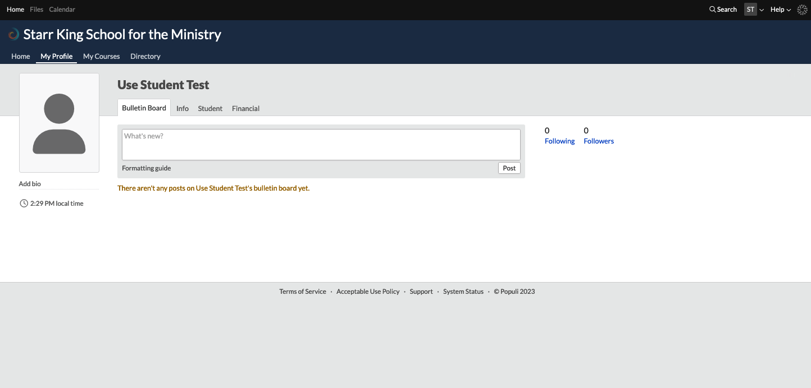
Success, you are in!

Slide 7
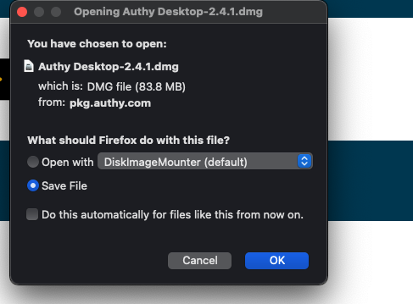
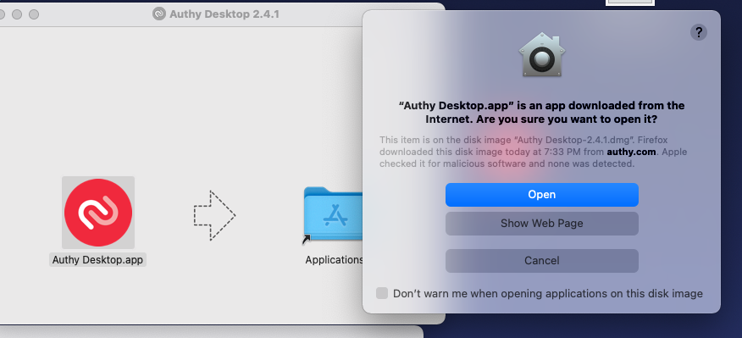
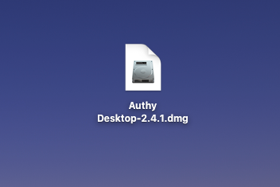
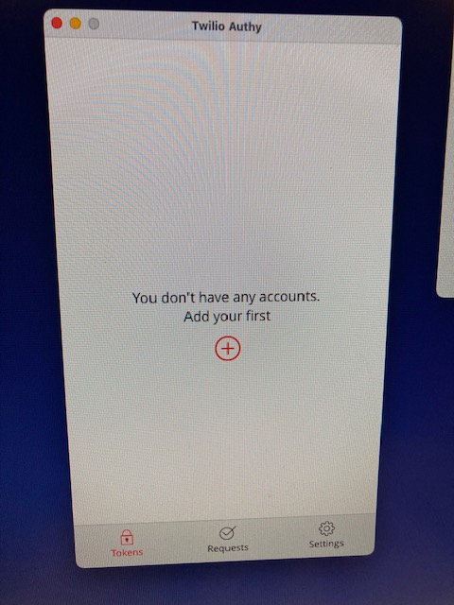
How to Download the Authy Authenticator App to Your Desktop and Set Up An Authy Account (YOU ONLY DO THIS ONCE, DURING SET UP)
1. Click Authy
2. Save the downloader
3. Double click Authy downloader
4. Click “Open”
5. Follow instructions for adding phone
10. Once you successfully input the one time code, you will see this screen and you are ready to add Populi to your Authy
6. Confirm phone
7. Follow instructions for adding email
8. Confirm email
9. Authy will send you a one time code by method of your choice
Notes:
Follow instructions to download and install the Authy app on your desktop (if you don’t have a smartphone) and set up your free Authy account.
NOTE: This step is only done once, when you first set up your Login Approvals. (Though if you get a new computer you would need to email Registrar@sksm.edu to “reset your Login Approvals”, and you would do this step again).

Slide 8
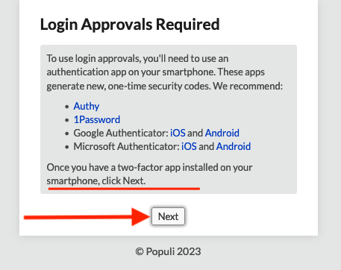
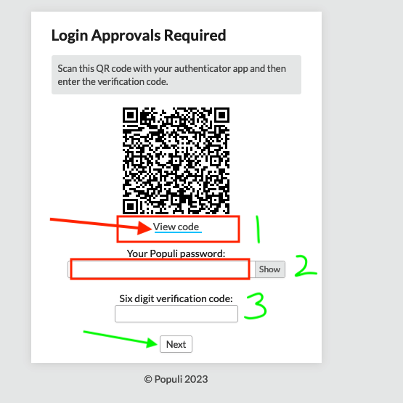
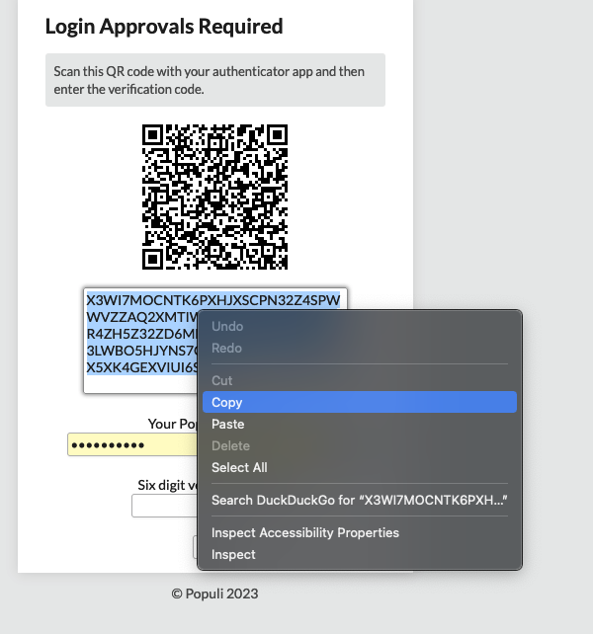
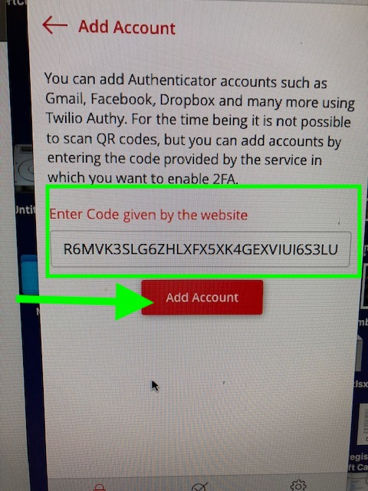
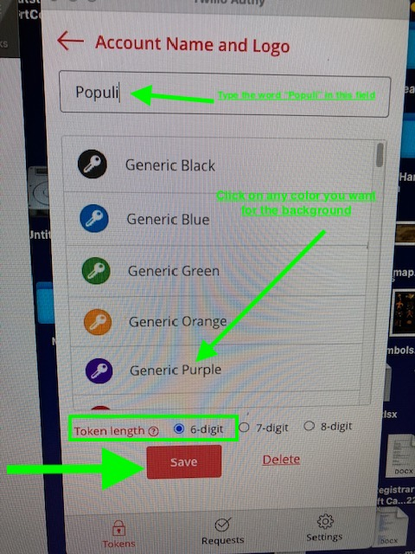
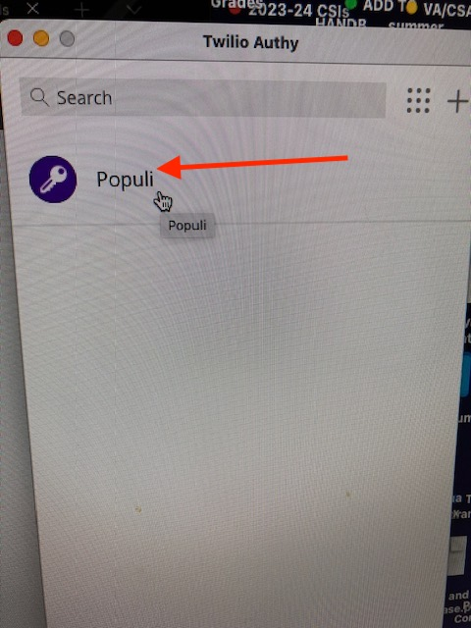
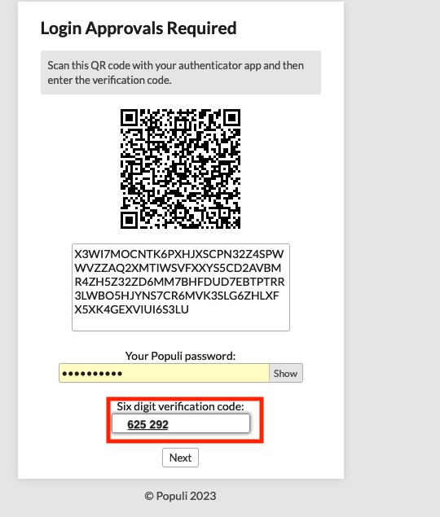
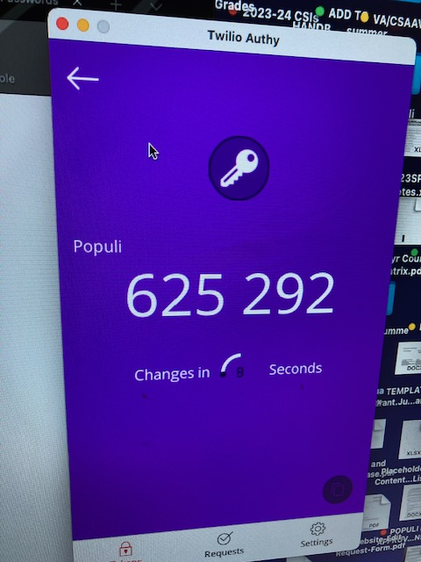
How to Link Your Authy Authenticator App on Your Desktop to Your Populi
(YOU ONLY DO THIS ONCE, DURING SET UP)
Now that you have Authy on your desktop,
click “Next”
3. Copy the long alphanumeric code
4. Open Authy on your desktop.
2. Hit “View Code”
5. Click the plus sign to add Populi to your Authy
6. Paste the long alphanumeric code into the field in the Authy app and hit “add account”
7. Type “Populi” into the box and pick a color by clicking on it. Make sure 6-digit code is selected, hit ”save”
8. Click “Populi”
9. This is your verification code (it will change every 60 seconds)
10. Be sure the alphanumeric code, your Populi password, and current 6-digit Authy verification code from your Authy app are all there, then click “next” to link your Authy to your Populi
Notes:
Follow instructions to link your Authy app on your desktop to your Populi IF YOU DON’T HAVE A SMARTPHONE.
NOTE: This step is only done once, when you first set up your Login Approvals.

Slide 9
Success, you are in!

Slide 10
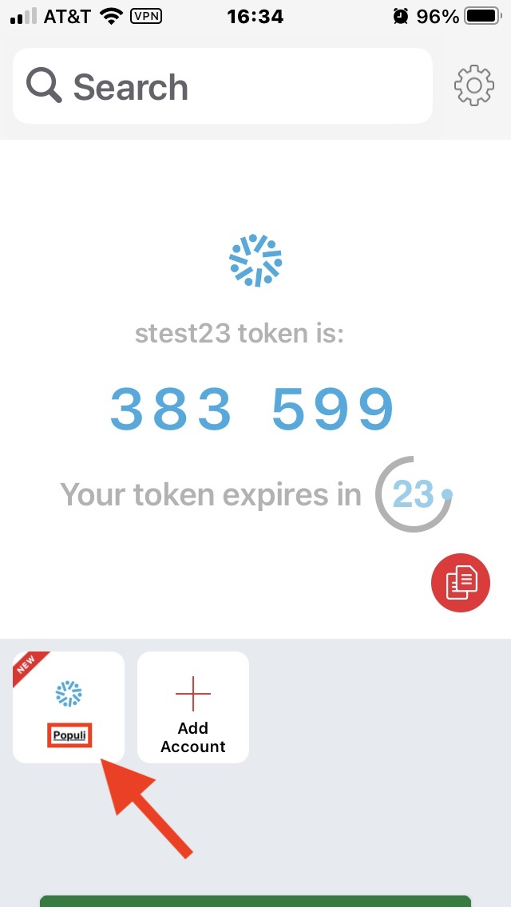
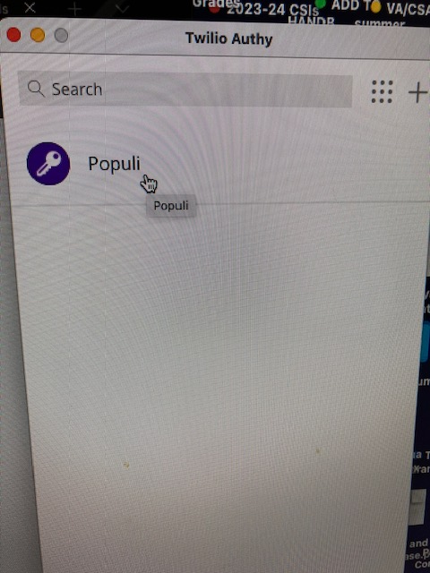
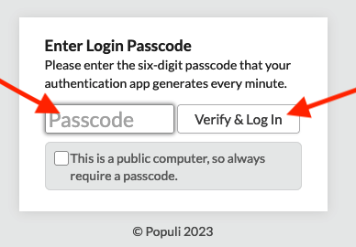
How to Log In to Populi Each Time Going Forward (using the smartphone or desktop Authy app)
2. Click “Populi” on your desktop or smartphone
4. Type the code into the Passcode field and click “Verify & Log In”
1. Click Authy app icon on your smartphone or desktop
3. Copy the 6 digit code before it changes (every 60 seconds)
Notes:
To access your Populi going forward, you do not need to do the entire process again.
Now that your Authy authenticator app is installed on your smartphone or desktop, when Populi asks you for a “Passcode” (which will be at least every 14 days), you just open your Authy app, type the 6 digit passcode into Populi, then click “Verify & Log In”
Remember the code will change every 60 seconds, so if you don’t type it into Populi in time you will have to put the next number that pops up into the Passcode field.

Slide 11
Any questions about today’s instructions?
You can email me any questions at Registrar@sksm.edu, and if you ever need a Populi password reset, or you need your Login Approvals reset (if you get a new a computer, phone, etc)
Notes:
You can also email me any questions at Registrar@sksm.edu, or if you need a Populi password reset, or you need your Login Approvals reset (if you get a new a computer, phone, etc)

