Slide 1
Religious identities and the constitution: some historical anecdotes
Constitution day at Starr king school for the ministry dr. christopher schelin Assistant professor of practical and political theologies

Slide 2
WHAT IS constitution day?
Created by act of Congress in 2004
Commemorates the drafting and adoption of the Constitution (The text was finalized on September 17, 1787)
Schools receiving federal funds are legally required to provide an educational program…which is probably unconstitutional!
https://slate.com/news-and-politics/2014/09/constitution-day-an-unconstitutional-federal-holiday-that-dictates-what-schools-must-teach.html

Slide 3
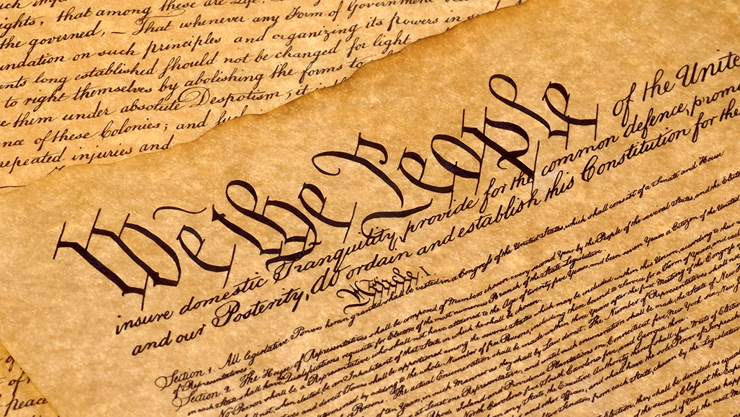
“…no religious test shall ever be required as a qualification to any office or public trust under the United States”

Slide 4
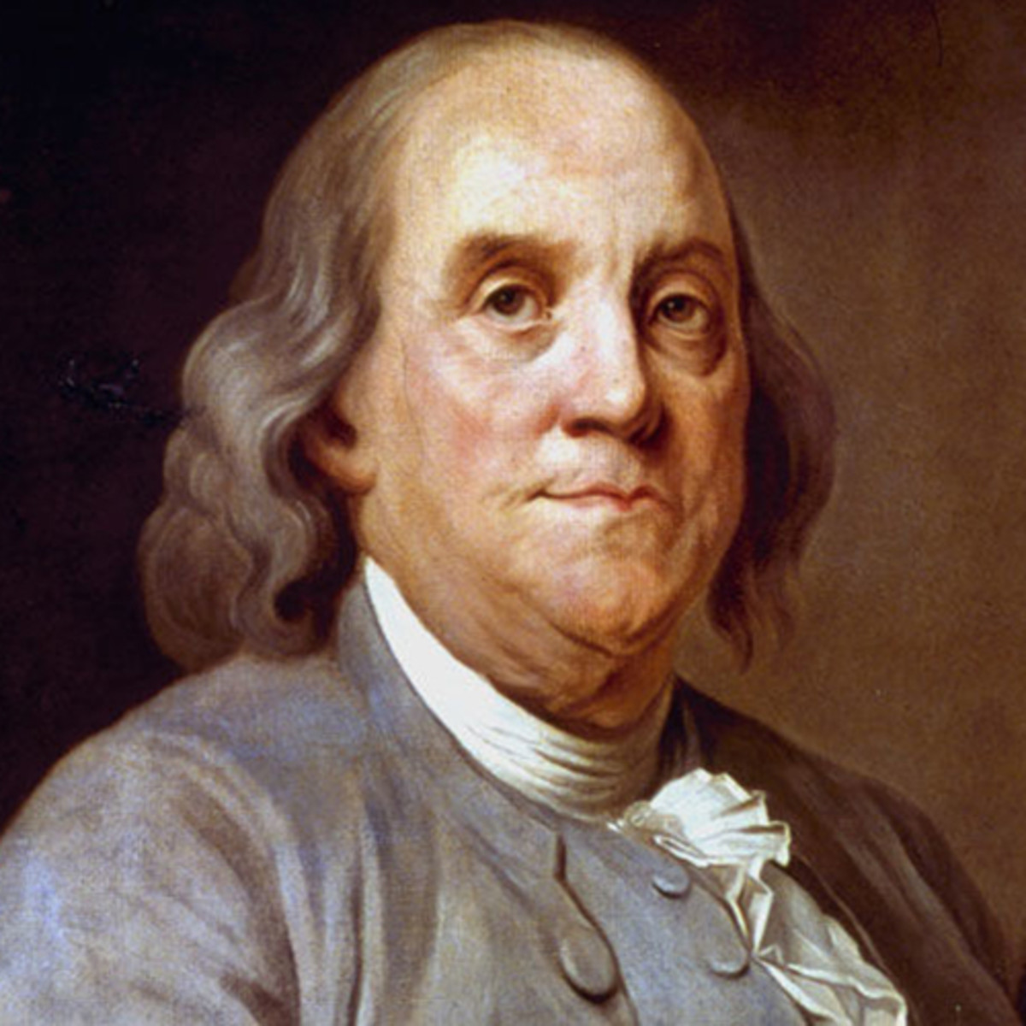
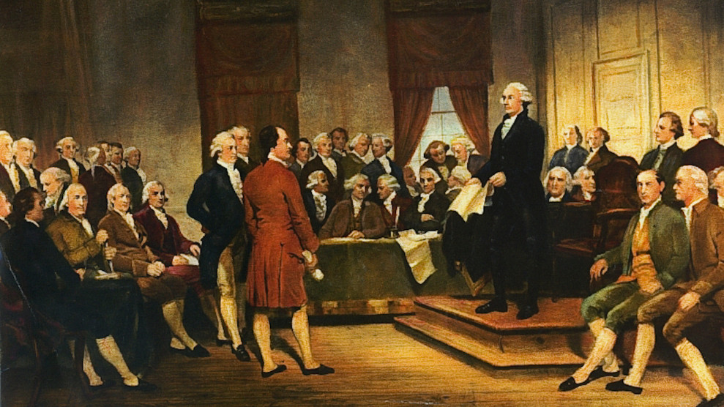

Slide 7
Thomas kidd, God of liberty
“…the framers of the Constitution intended to create neither a specifically Christian government nor a ‘godless Constitution.’ Instead, led by James Madison, they established a new government committed to maintaining public virtue.”

Slide 8
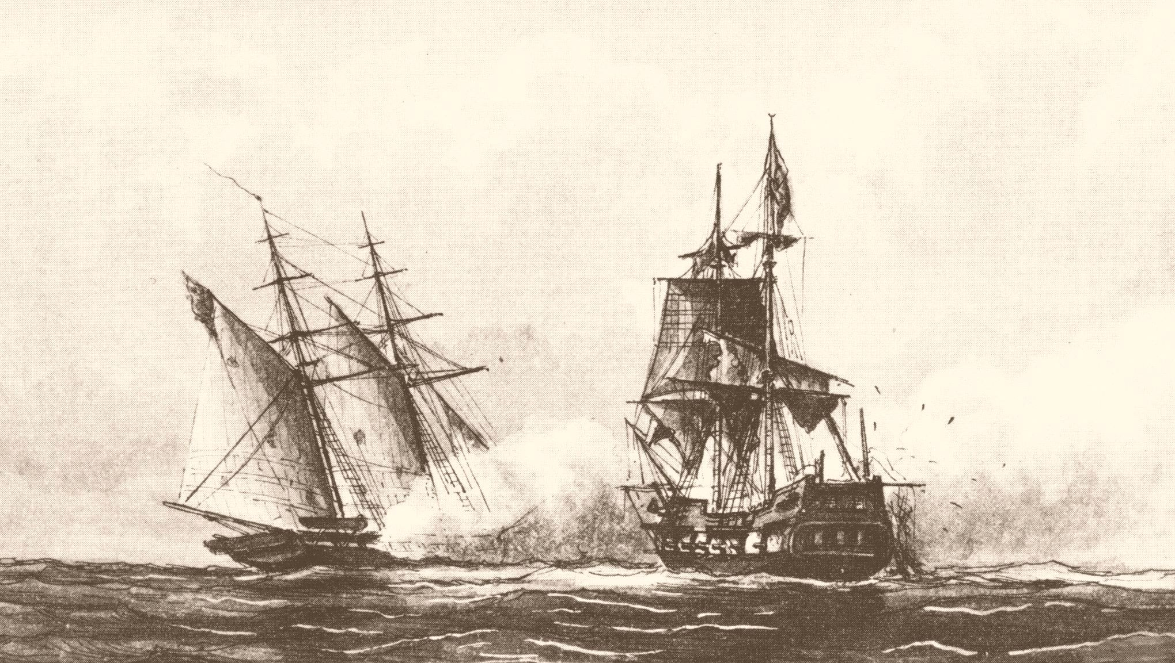

Slide 9
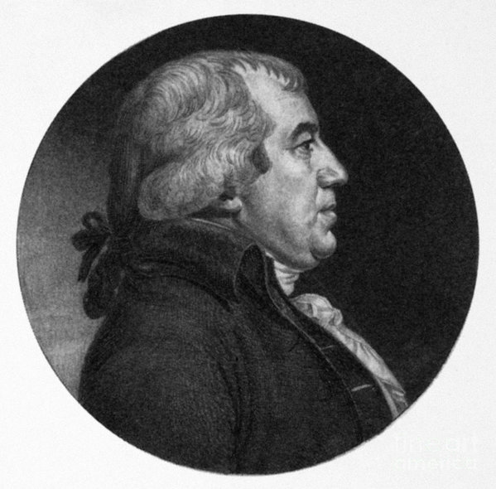
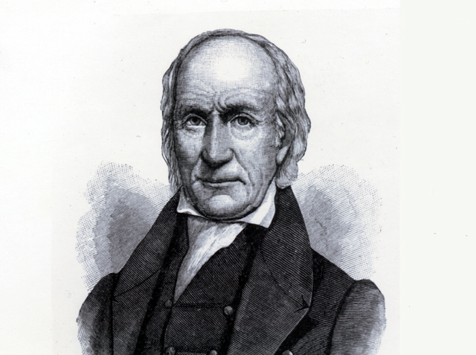

Slide 11
SOURCES
Daniel L. Dreisbach, Reading the Bible with the Founding Fathers. New York: Oxford University Press, 2017.
Thomas S. Kidd, God of Liberty: A Religious History of the American Revolution. New York: Basic Books, 2010.
Peter Manseau, “Why Thomas Jefferson Owned a Qur’an.” Smithsonian.com, https://www.smithsonianmag.com/smithsonian-institution/why-thomas-jefferson-owned-qur-1-180967997/ (31 January 2018).
Denise A. Spellberg, Thomas Jefferson’s Qur’an: Islam and the Founding Fathers. New York: Alfred A. Knopf, 2013.

